Slide 1
Capstone Project
Presented By Group - eShield
Rajiv, Chintan & Hardik

Slide 2
Objective
Random Forest
To analyze the characteristics of individuals susceptible to falling victim to online transaction fraud.

Slide 3
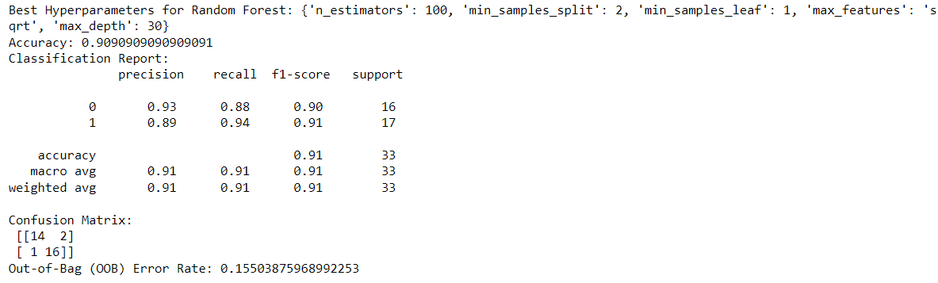
Random Forest
Devide Data Set
RF
Hyperpara-meters Tuning
Performance Matrics
Training Data Partiton : 80%
Testing Data Partiton : 20%
Random Forest hyperparameter tuning
Accuracy -Train Data = 100%
Accuracy -Test Data = 91%
OOB Eroor Rate = 15.5%

Slide 4
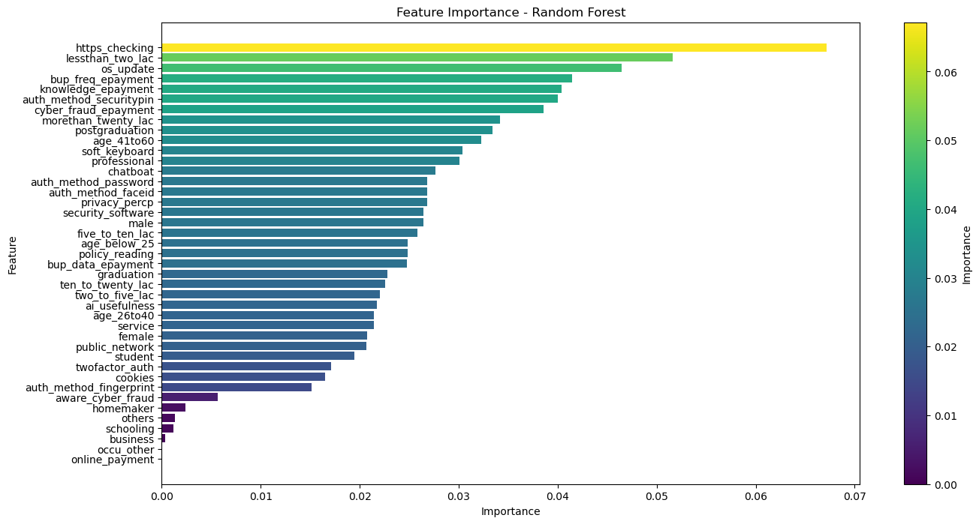
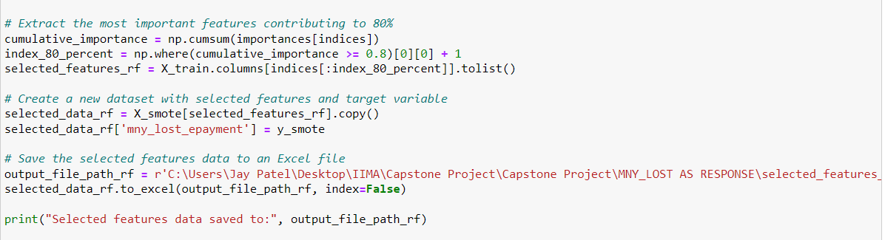
Random Forest
Random Forest
Important
Features
Pareto Rule
Application
Pareto Rule: Application

Slide 5
Random Forest
Important
Features
Pareto Rule
Application
Final Filtered
Features
Pareto Rule: Application
Important Features: 41
Filtered Important Features : 22

Slide 6
Model Prediction- Logistic Regression
Building Predictive
Logistic Regression
Model
Dividing Data Set
Raw Data
Training: 70%
Validation: 15%
Testing: 15%

Slide 7
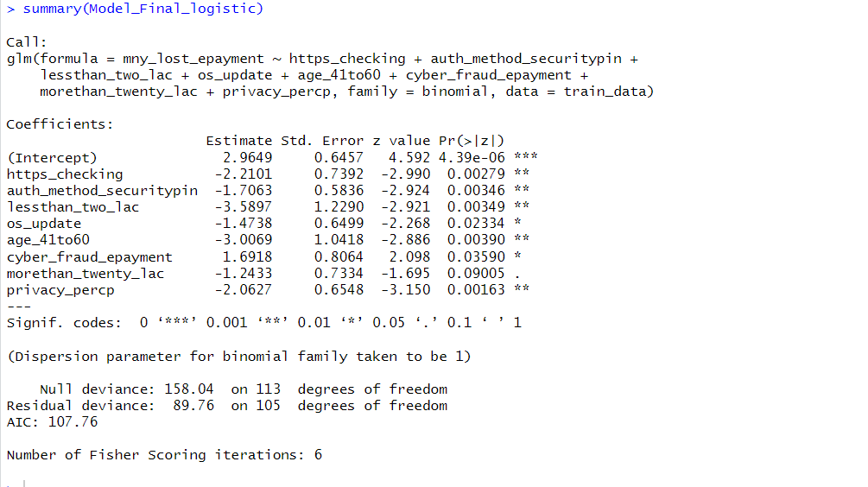
Logistic Regression
Logistic
Regression
Back ward
Elimination
Final Model
Summary
Model Summary
Back ward Elimination Method
Threshold Value Cut off
VIF<4
P value < 0.1

Slide 8
Logistic Regression

Slide 9
Logistic
Regression
Back ward
Elimination
Final Model
Summary
Significant Variables
8

Slide 10
Logistic Regression
Probability - insights
Parametrs | Lossing Money Probability(%)
HTTPS Not checking | 90%
Annual Salary < 2 Lkahs | 81.36%
Not updating OS | 95%
Other than Postgraduates | 84%
Other than Professionals | 77%
Probability is counted when other variables are kept constant in LR Model

Slide 11
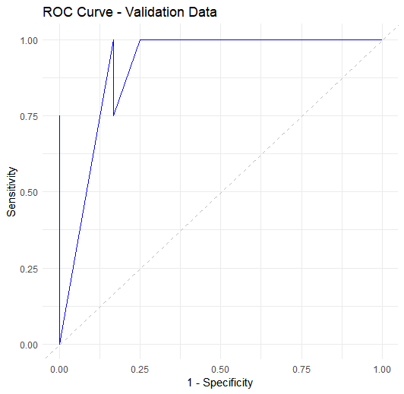
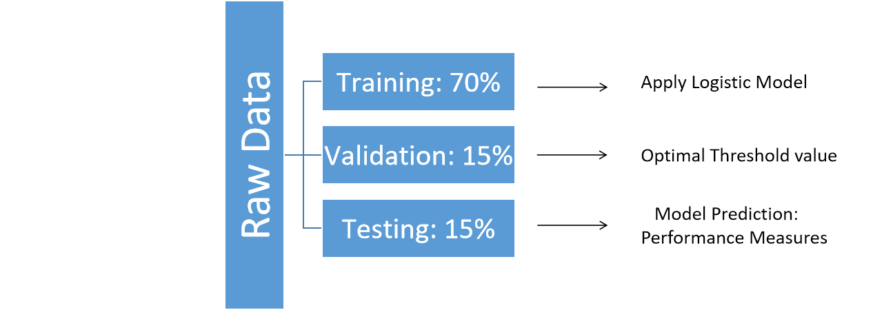
Model Prediction- Logistic Regression
Optimal Threshold
F1 Score
Priority

Slide 12
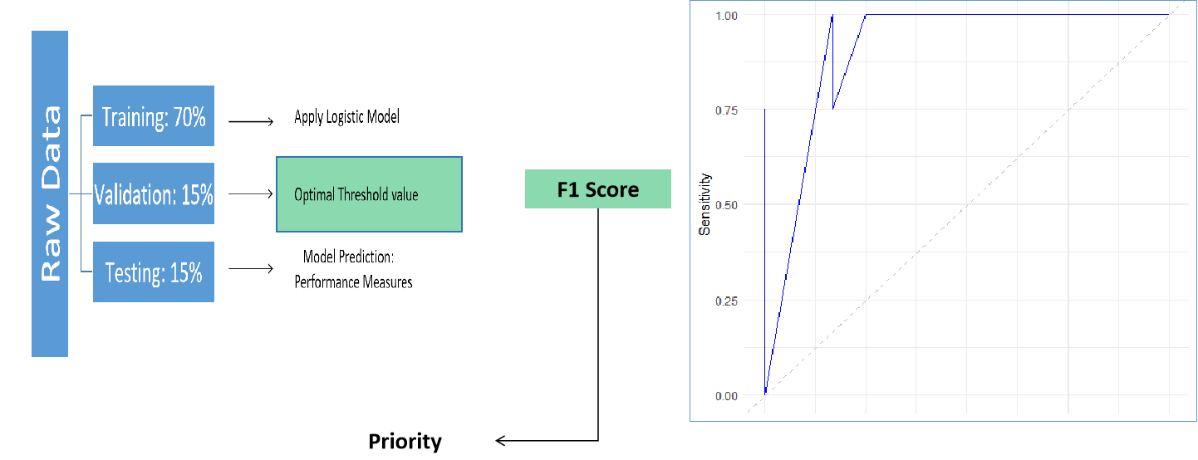
Model Prediction- Logistic Regression
Optimal Threshold
Optimal Threshold: 0.23
AUC: 0.95

Slide 13
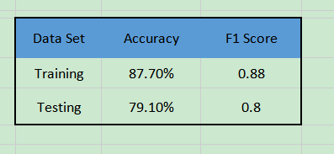
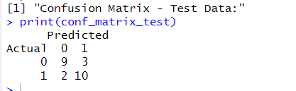
Model Prediction- Logistic Regression
Optimal Threshold
Performance Matrics Comparision

Slide 14
Thank You

Slide 15
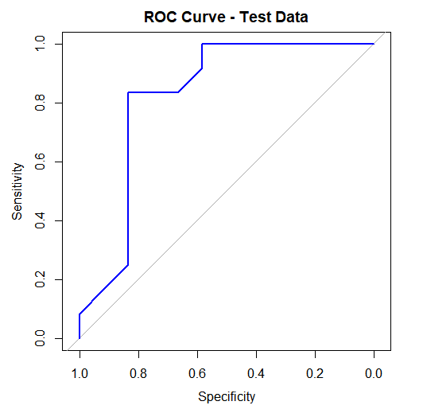


Slide 16
